Slide 1
Digit DP
RUCP Fall 2020 Advanced Lecture #11

Slide 2
Digit DP
Have range [0, a]
Predicate P(x) (usually dealing with digits or mods etc.)
Function f(x) (usually either count or sum or something)
Want to calculate f({ 0 ≤ x ≤ a | P(x) })
(count / sum of numbers in [0, a] that satisfy P(x))
a is usually around 10¹⁸, want O(lg(n)) solution

Slide 3
Trivial Example
a = 123456
x = 122* * * complete freedom
y = 123d___ d <= 4
Given a ≤ 10¹⁸, print number of nonnegative integers ≤ a
Let's do dp on digit idx
At every dp state, we’ve fixed some prefix of the number
If we've went below digit of a in the past, we can do any digit we want
Otherwise can only go up to digit of a

Slide 4
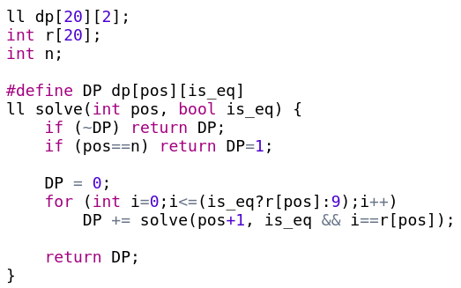

Template
Keep track of whether we're constrained
Try all digits that we can
n is number of digits in a
answer is:

Slide 5
Digit DP
O(lg(n)) because lg(n) digits
What if we want [a, b]
ans(b) - ans(a-1)
For actual P(x)/f(x) we can keep info to calculate that in the dp

Slide 6
Actual Example
Example: count numbers in [a, b] where sum of digits ==k
a,b ≤ 10¹⁸, k ≤ 100
Add a state to the DP representing current digit sum
Update is possible because we pick actual digits

Slide 7
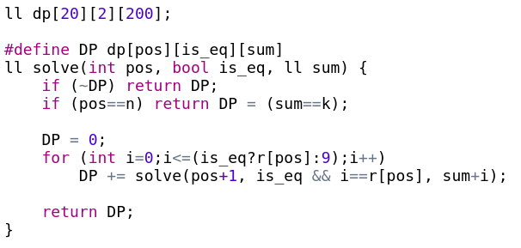
Actual Example - Implementation

Slide 8
Problems

Slide 9
Investigation
The number of integers in the range [A, B] which are divisible by K and the sum of its digits is also divisible by K.
A≤B<2³¹ and K<10000
Ex: 3720 is divisible by 3 and (3+7+0+2) = 12 is also divisible by 3

Slide 10
Investigation - Solution
Same idea as last problem
Also maintain DP param for remainder mod K
adding digit to rem is transition: (rem(10) + digit) % k
O(lg(n) (MAX_SUM) K) = O(lg(n)² K) ~= 10(10)10000 = 10⁶

Slide 11
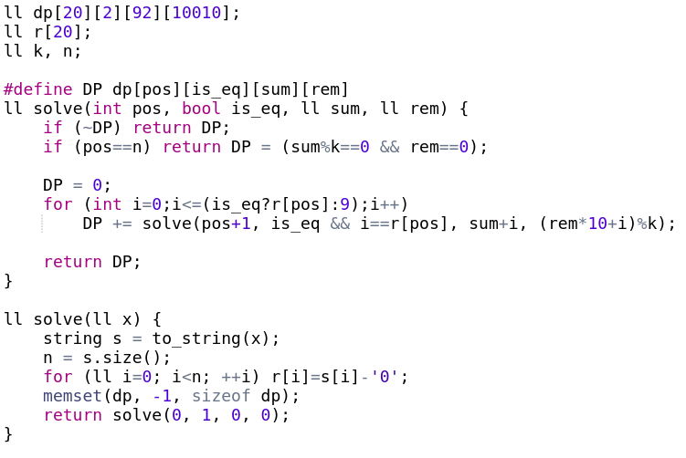
Investigation - Implementation

Slide 12
Sum of Digits
Sum of digits for all numbers from a to b
a, b ≤ 10⁹

Slide 13
Sum of Digits - Solution
Same as example problem but dp stores sum
We also need count to update sum
Use a pair
Transition for current is sum += d*count

Slide 14
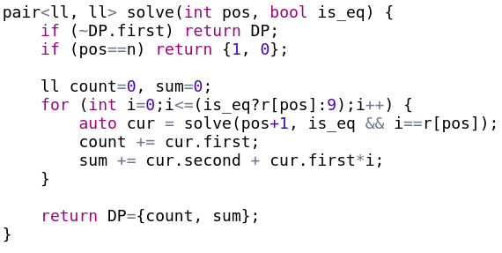
Sum of Digits - Implementation

Slide 15
Chef and Special Numbers
K-special number contains K or more digits that it is divisible by
48 is 2-special because 4|48 and 8|48 (so it is also 0,1-special)
Count K-special numbers in [a, b] (a,b ≤ 1e18)

Slide 16
Chef and Special Numbers - Solution
To check divisibility by multiple numbers we only need mod by lcm
lcm(1, 2, 3, 4, 5, 6, 7, 8, 9) = 2520
Bitmask to keep track of which digits we have: 2⁹ = 512
20(512)2520 ~=3e7

Slide 17
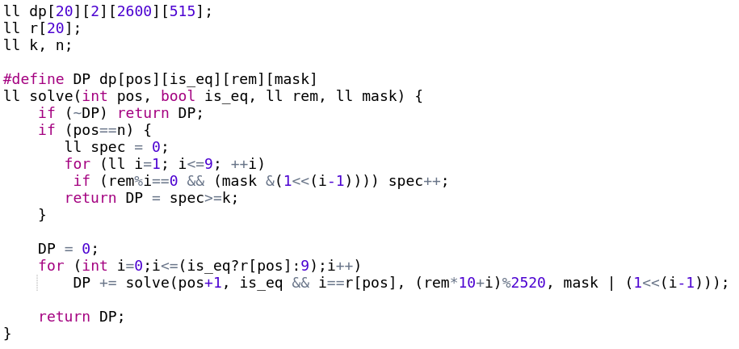
Chef and Special Numbers - Implementation

Slide 18
Spring Cleaning
How many pairs of numbers L ≤ a , b ≤ R satisfy: a + b = a ⊕ b
L ≤ R ≤ 1e9
Example: 3 ⊕ 4 = 7 = 3 + 4

Slide 19
Spring Cleaning - Hint
a + b = a ⊕ b + 2(a & b)
So we need a & b = 0
Can't both be 1 on any bit

Slide 20
Spring Cleaning - Solution
We don't need to do base 10: base 2
Instead of doing ans(b) - ans(a-1) keep lower and upper constraints
Do this for both numbers
Check all possible digit combinations at that position

Slide 21
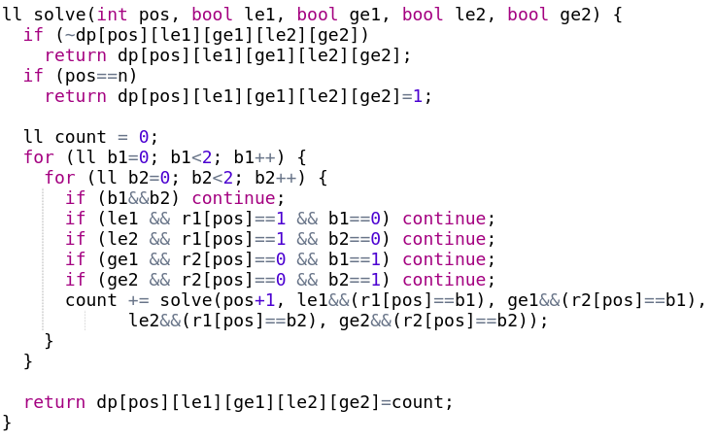
Spring Cleaning - Implementation

Slide 22
Thanks for coming!
Links to problems from the lecture are on the next slide!
Link to folder with these slides (and our other slides) is in #info channel on Discord

Slide 23
Problems
Sum of Digits
Daniel and Spring Cleaning
Investigation
Chef and Special Numbers
Codeforces blog on Digit DP - has more problems!

